Slide 1
SOFTWARE SYSTEM DESIGN SEC-402
URL SHORTEN SYSTEM
Aug. 10, 2023

Slide 2
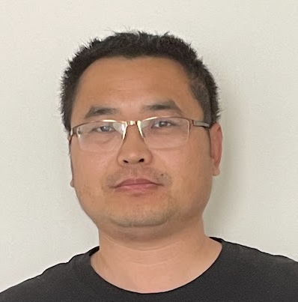
MEET OUR TEAM
//Hidden for Privacy
Noorulhuda Khamees
Dongli Liu
Software Engineering Technology Student
Software Engineering Technology – AI Student

Slide 3
AGENDA
Problem & Overview
Modularization
MVC & Sequence & State Diagrams
Design Patterns
UI/UX Design
Deployment Diagram
Gantt Chart

Slide 4
Problem & OVERVIEW
PROBLEM
Growth need of short links
OBJECTIVE
Create a robust and user-friendly URL shorten system
CAPABILITIES
Shorten Links
Customize Links
Redirect Links
Analyze Clicks
STAKEHOLDERS
BENIFITS
Sharing efficiency
Link management
Track clicks
Netizens
Marketing staffs
Data Analysts
Developers
Product Managers
…

Slide 5
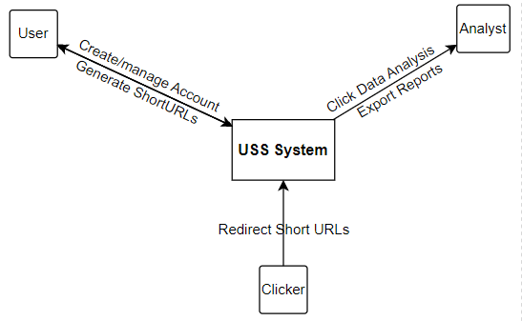
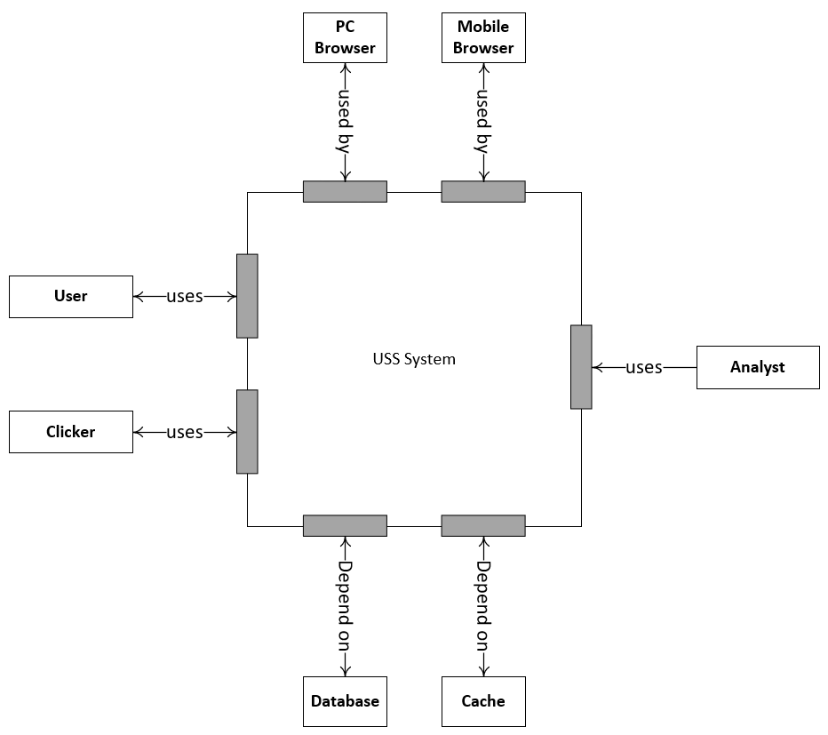
Problem & OVERVIEW
What?
How?

Slide 6
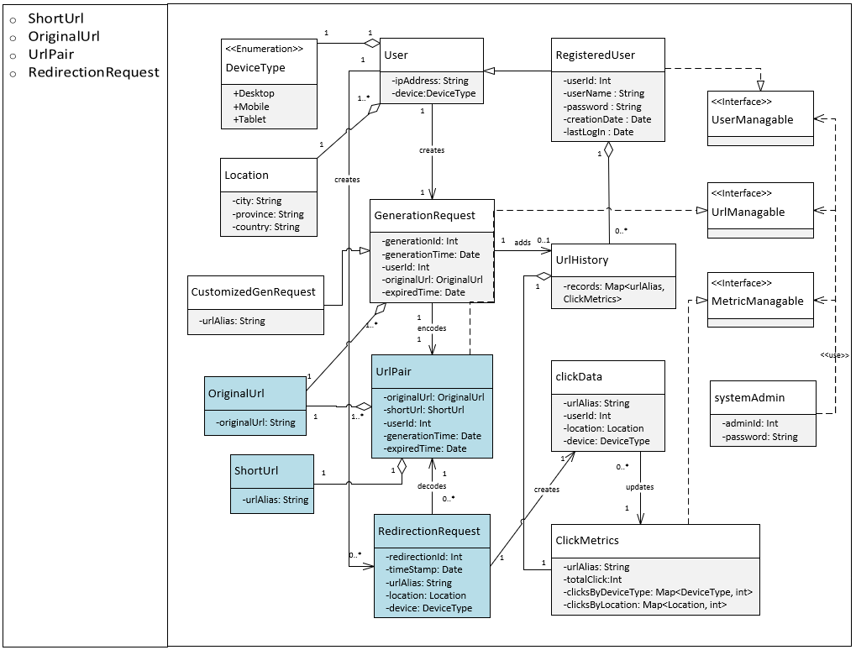
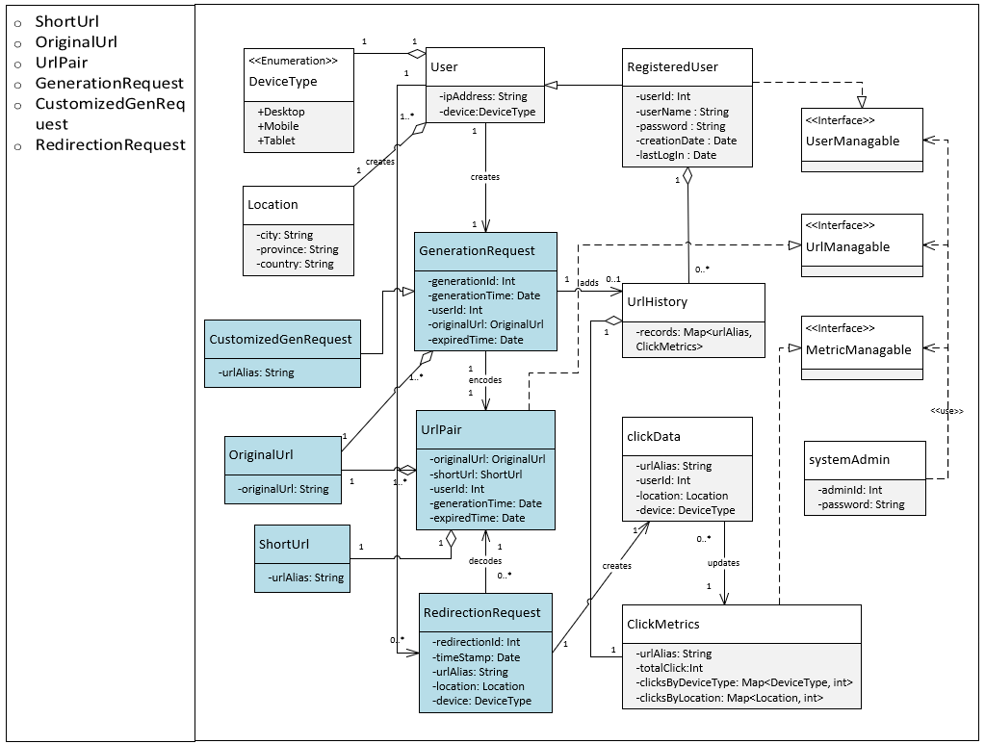
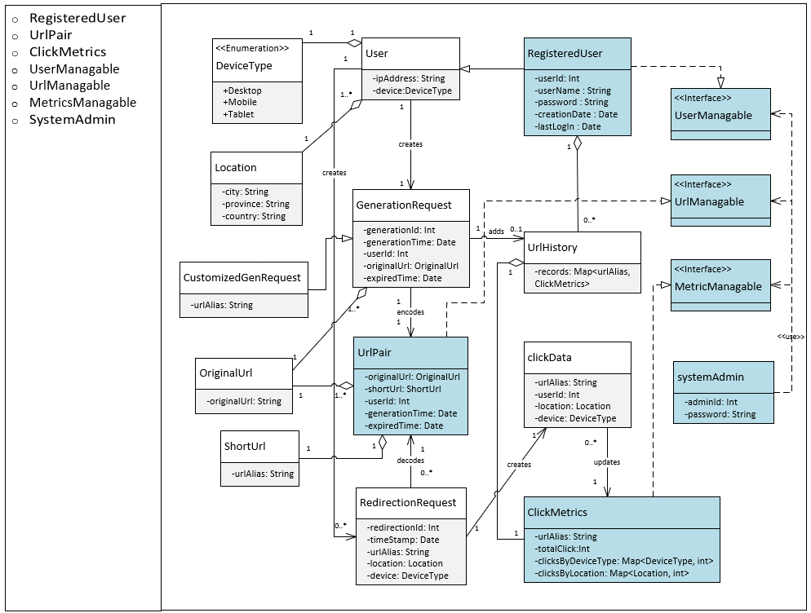
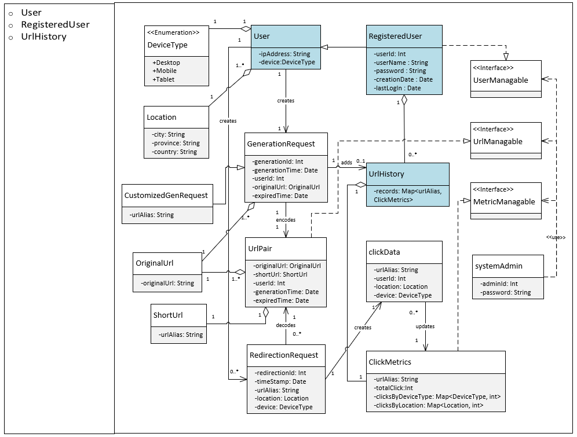
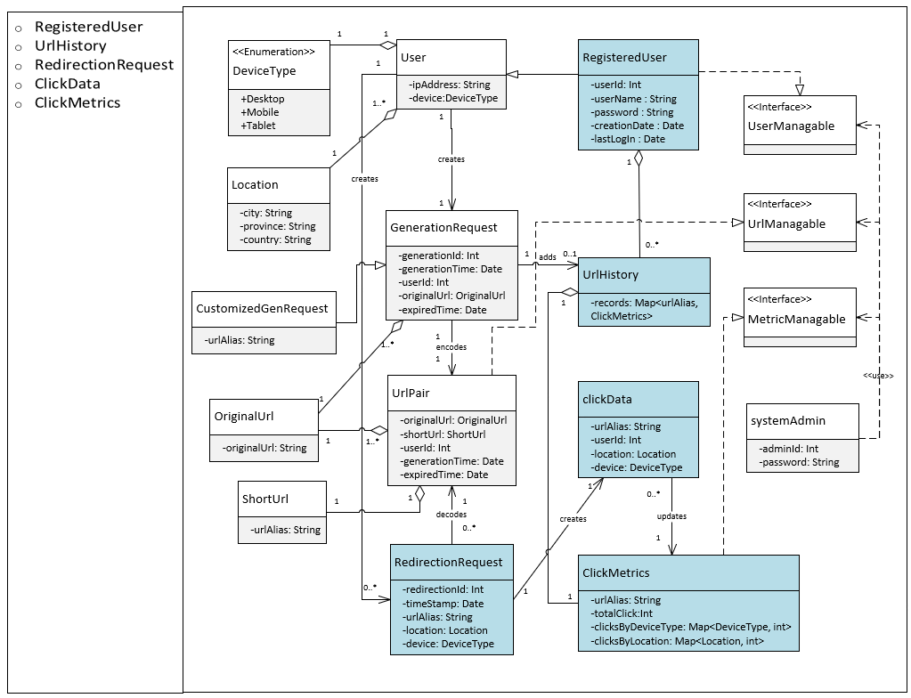
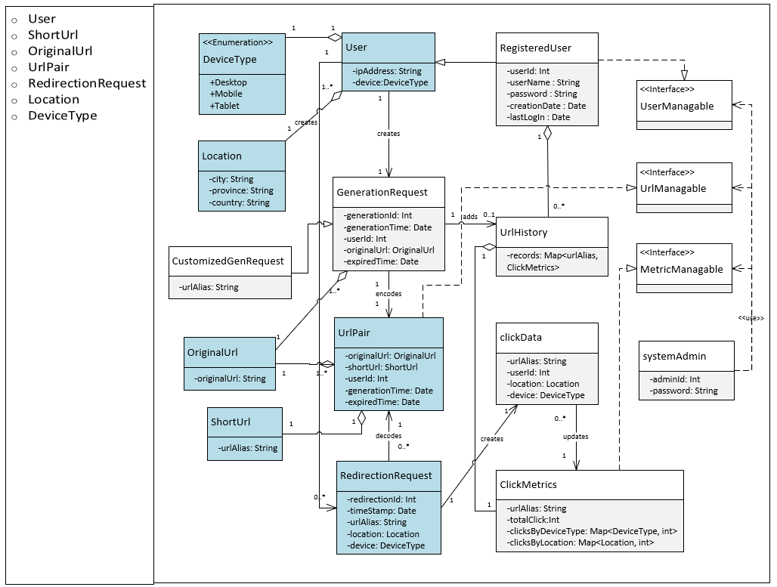
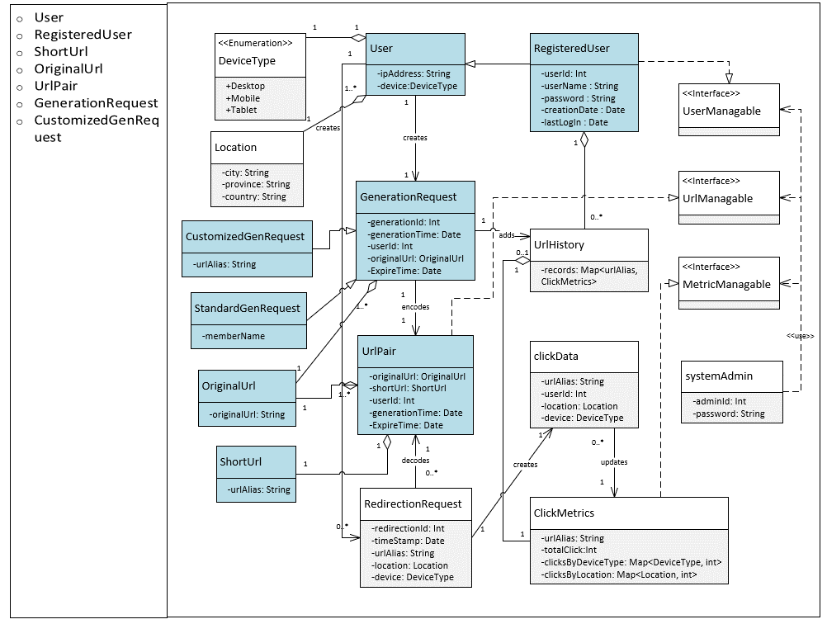
Modularization
Caching Mechanism
Database Management
System Administration
User Management
Analytics
Redirection
URL Shortening

Slide 7
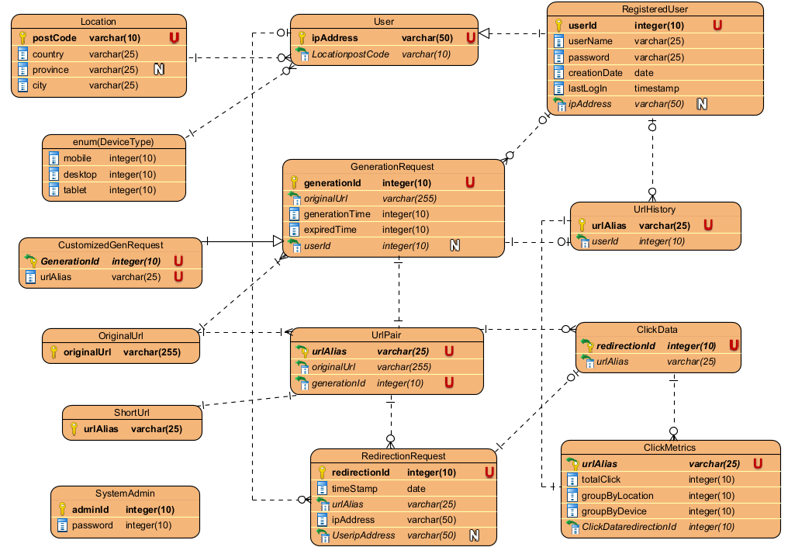
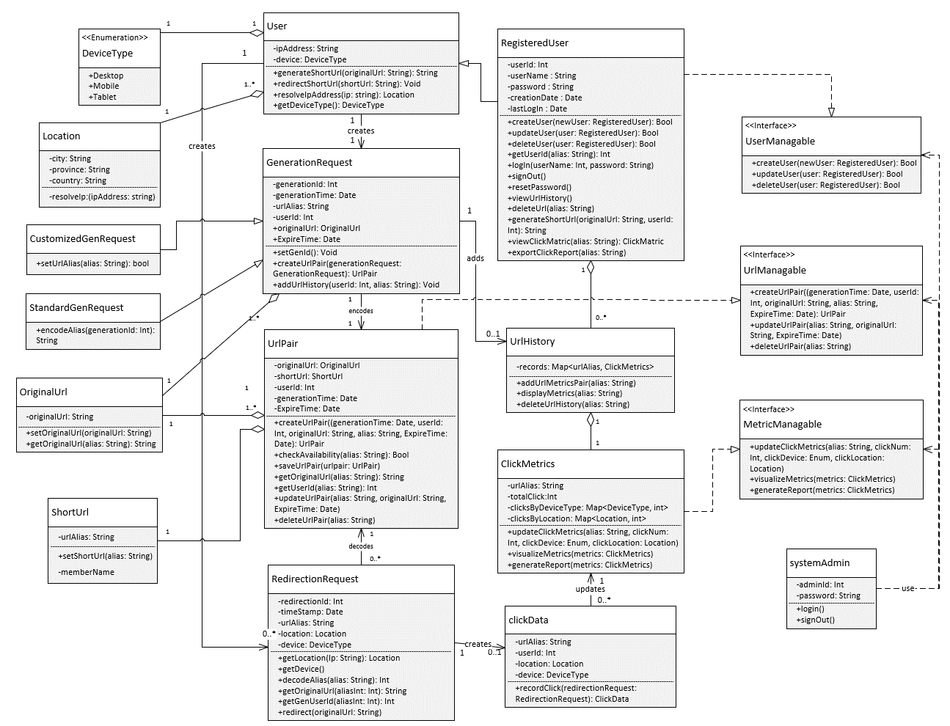
Modularization
Complete Class Diagram
Data Layer

Slide 8
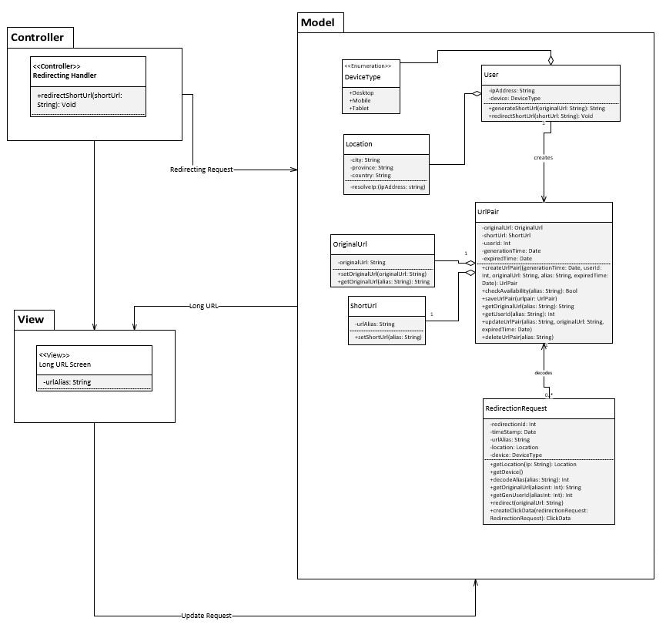
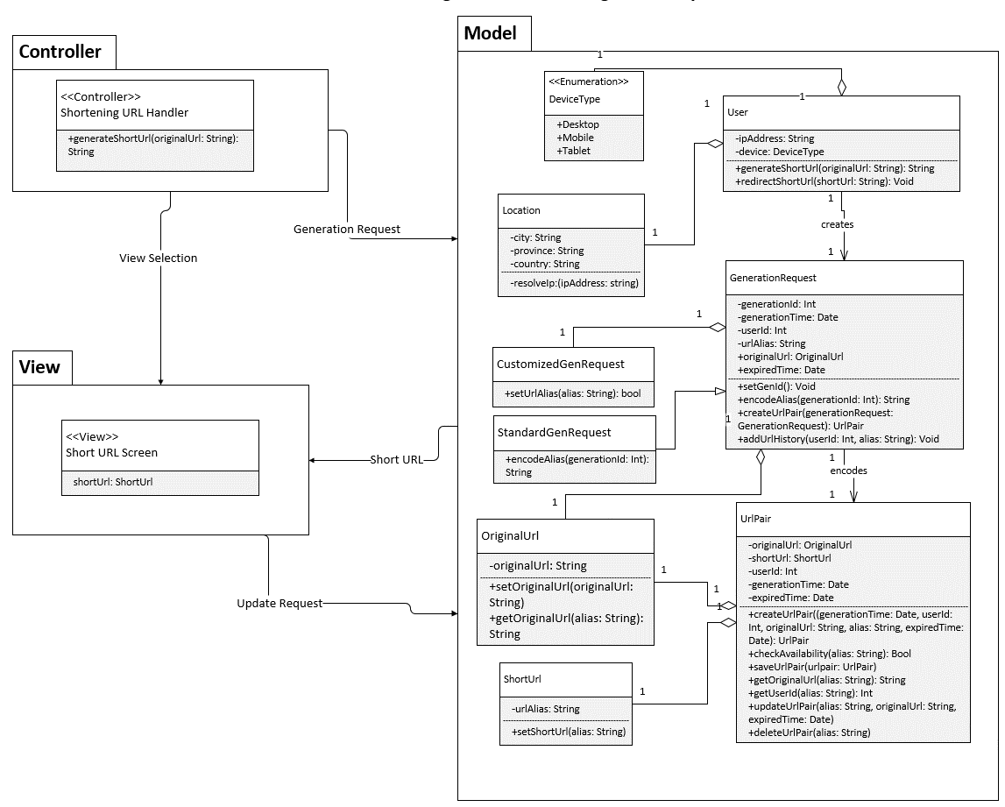
Model View Controller
URL Shortening Subsystem
Redirection Subsystem

Slide 9
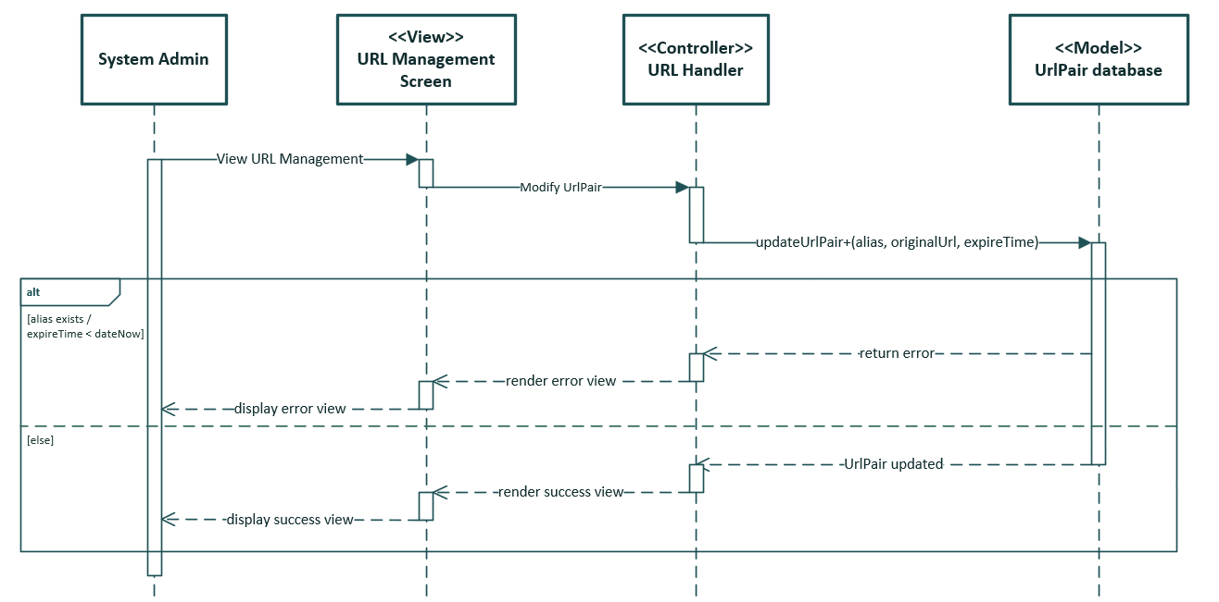
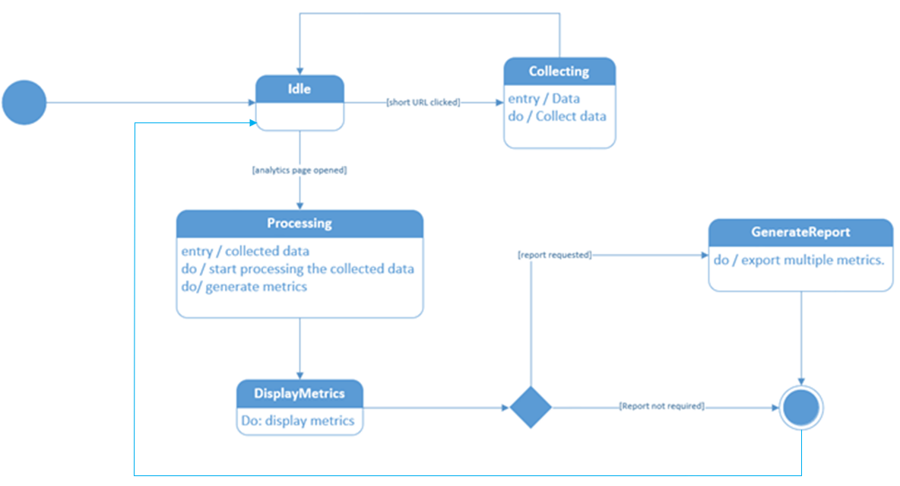
Sequence & State Diagrams
Manage URLs Sequence Diagram
State Machine Diagram

Slide 10
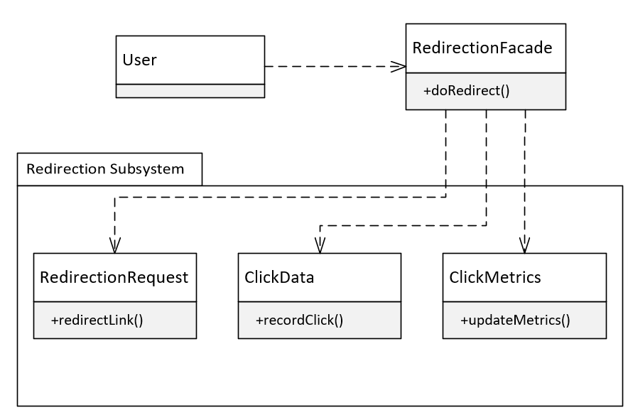
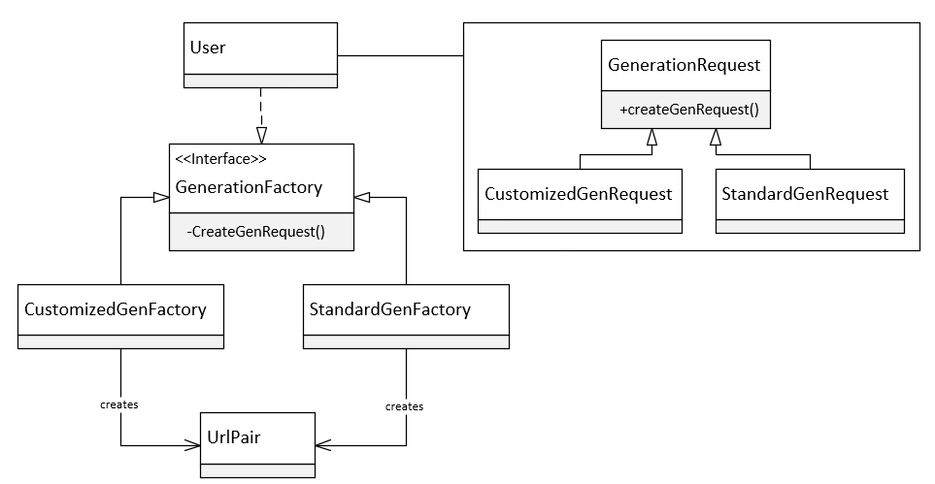
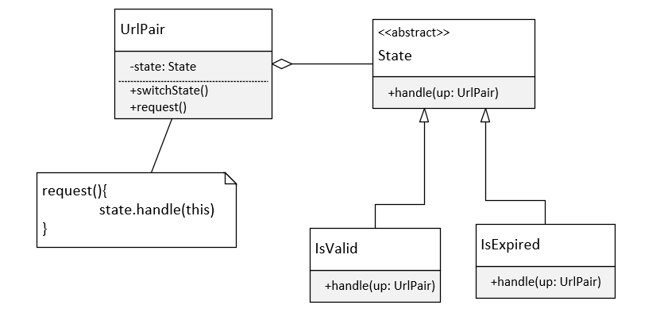
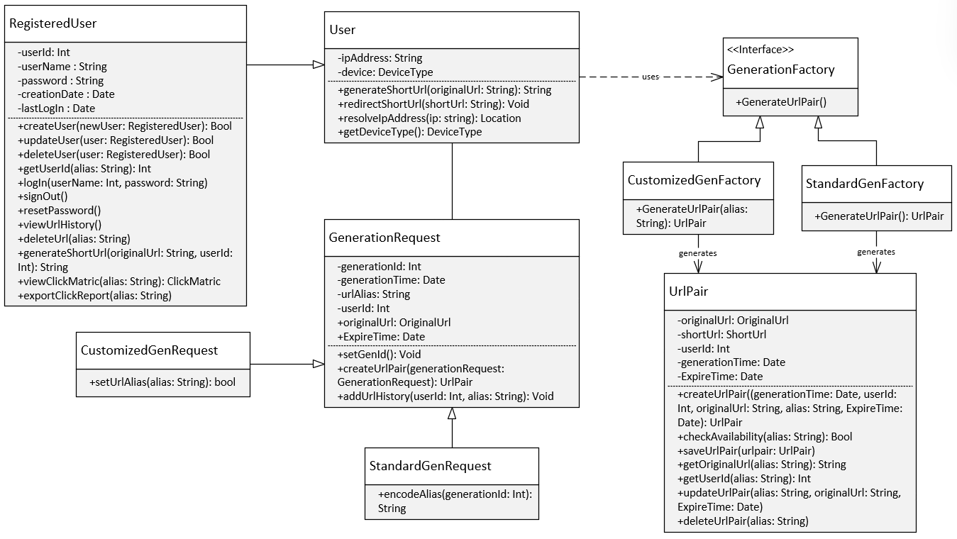
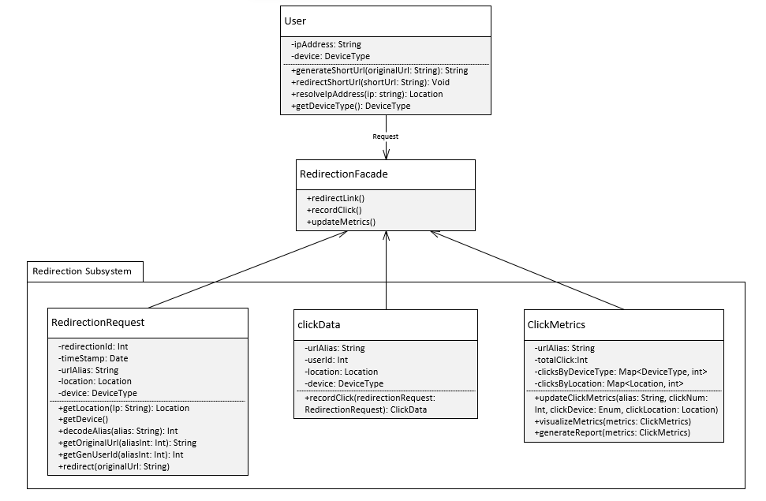

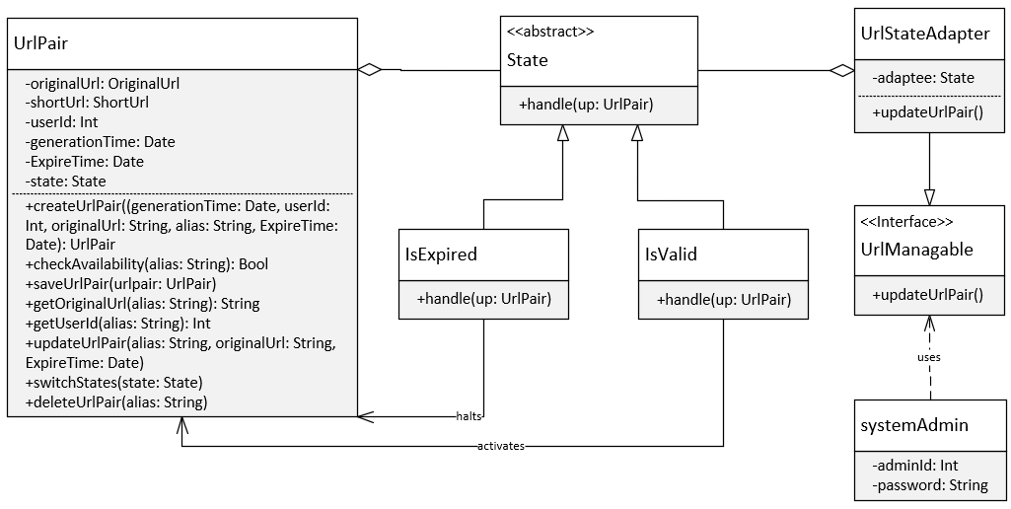
Design patterns
Factory Pattern
- generation
Façade Pattern
- redirection
State Pattern
- expiration

Slide 11
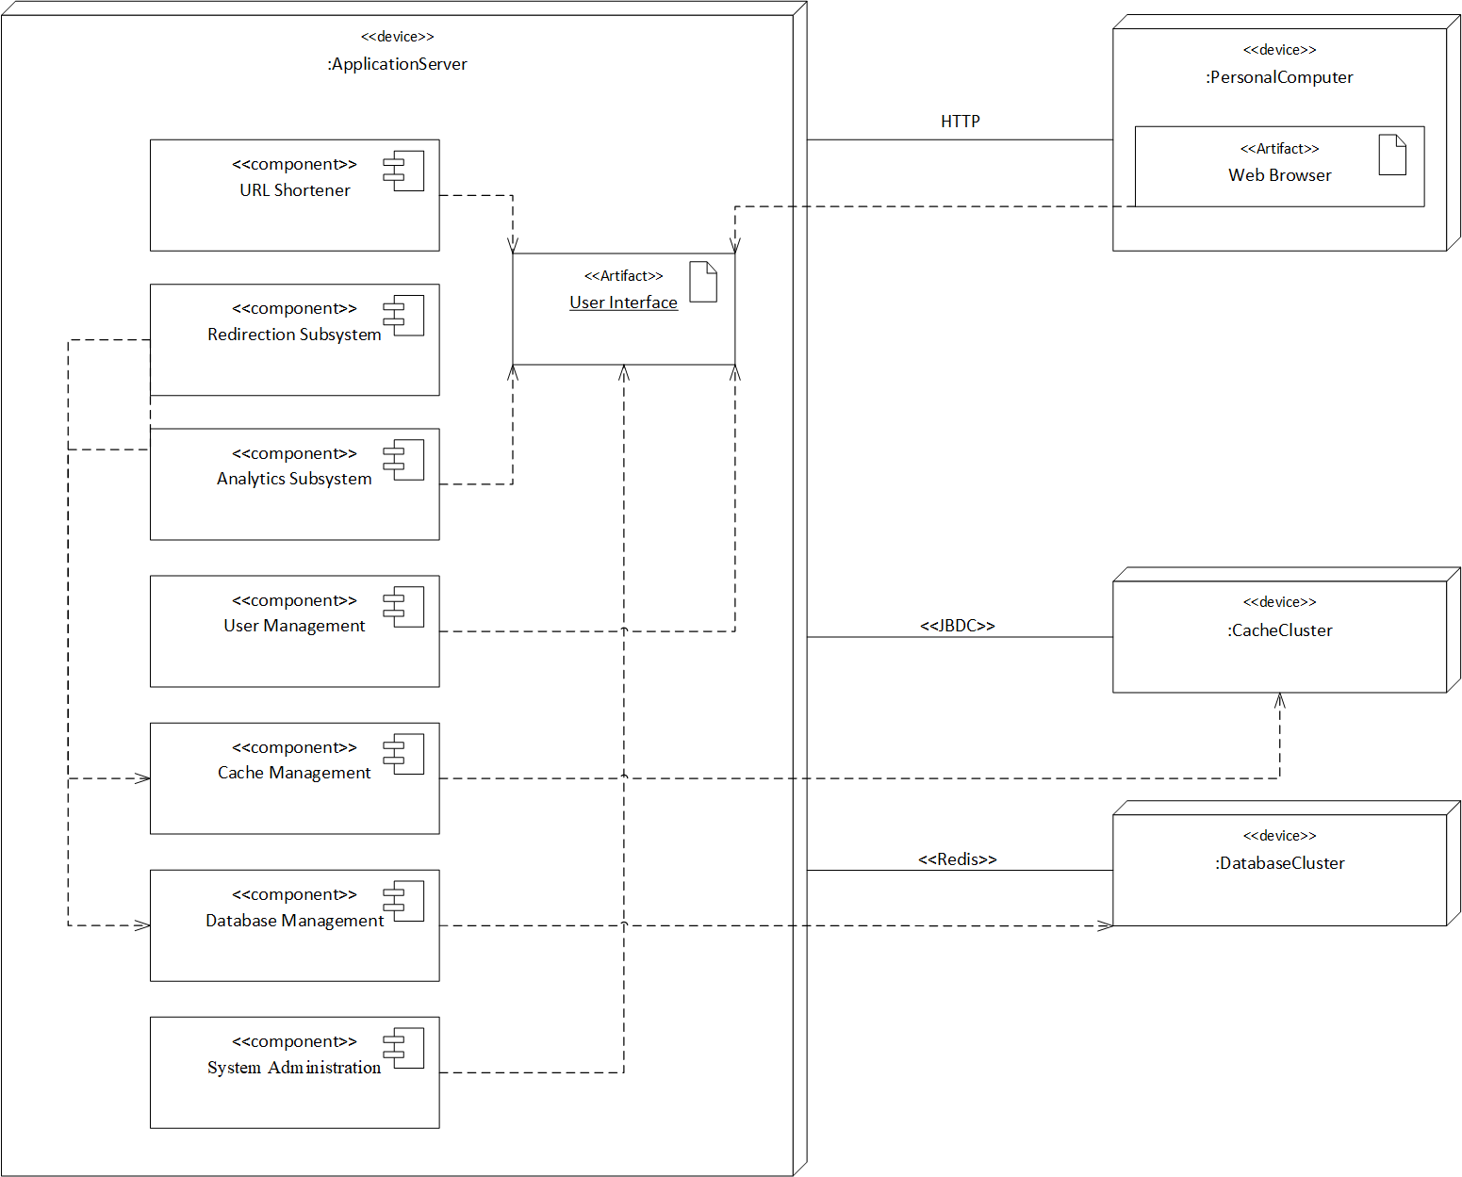
Deployment diagram

Slide 12
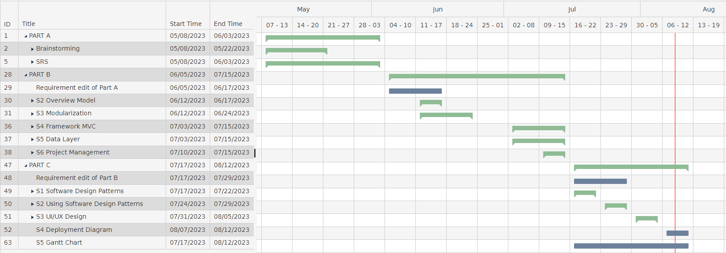
Gantt chart

Slide 13
THANK YOU
Dongli Liu dliu99@my.centennialcollege.ca
Noorulhuda Khamees nkhamees@my.centennialcollege.ca

